Slide 1
Big Data-Based Agri-food Recommendation System According to Types of Customers
KHIN CHAN MYAE AUNG

Slide 2
Characteristics of Recommendation System
1) Utilization of data in the agricultural sector
2) Using the consumer segmentation method based on the dietary lifestyle and Megatrends factors
3) Recommended agricultural products that reflect the preferences of various situational factors
Information of SNS restaurants and Buzz Quantity on recommended farm products
Provide location and price information of nearby retailers selling related food materials

Slide 3
Purpose of Development
Expanding users by providing information on agricultural products tailored to consumers' needs
-> Promote consumption of local agricultural products in conjunction with the direct agricultural trading platform linking producers

Slide 4
Recommended Techniques
1) 내용기반 (content-based)
2) 협력기반 (collaborative)
3) 하이브리드 (hybrid)

Slide 5
Food Recommendation System
For Patients
- Recommend foods based on nutritional information for patients who need to manage their diet
- Recommend foods with specific conditions, including the DB of food containing nutritional information.
For General
- Recommend a healthy diet
- Recommended menu of favorite food-based consumers

Slide 6
Recommended Algorithm Based on Latent Dirichlet Allocation
Topic Modelling Algorithm
Dirichlet distribution + Multinomial distribution
Dirichlet Distributions -- Continuous probability distribution with probability values defined when the element of the backter is positive in k dimension, and the value of all elements plus one
Multinomial distribution -- Probability distribution for independent probabilities variables that may have multiple values. The probability that each value will appear a certain number of times in several independent trials
LDA => Word Distribution for Topics + Topics Distribution for Documents = Generate Words in Documents
LDA inference => Inverse LDA

Slide 7
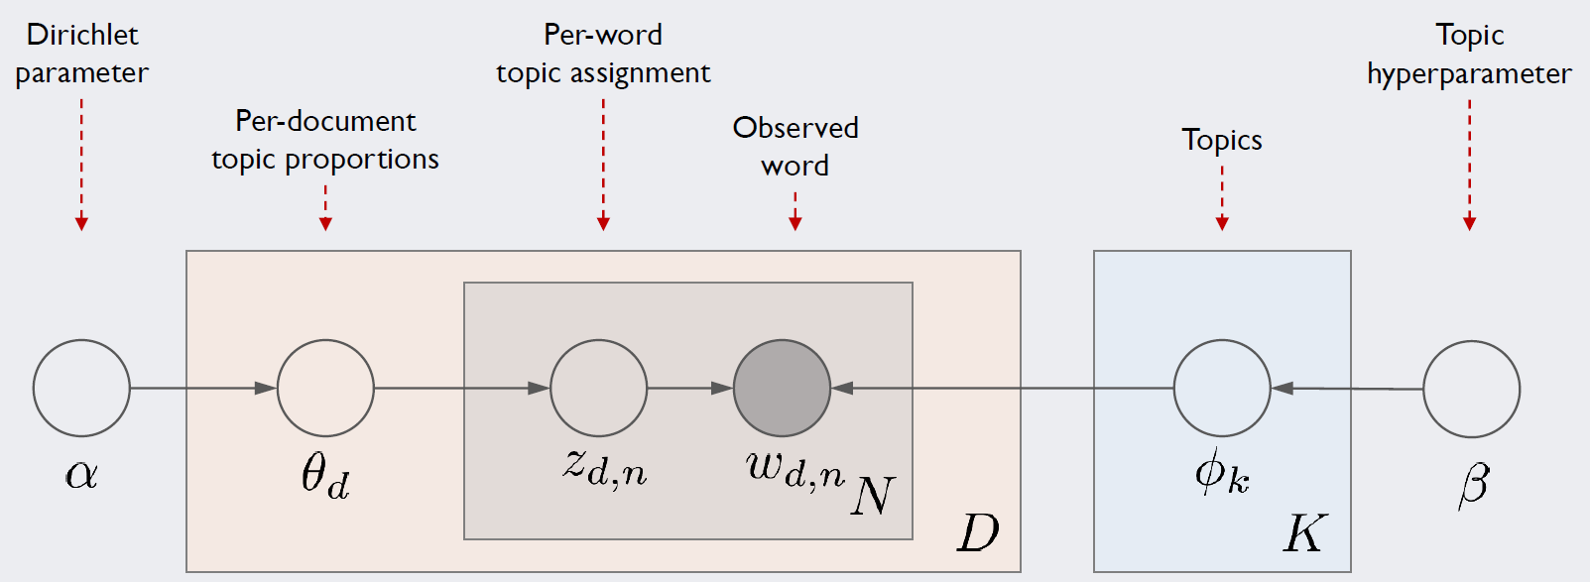
Document Creation Process by LDA
D – Total Documents
K – Total Topics
Retangular – Repeat as many times as you want.
Circular – Variables
α,β – hyperparameter
W(d,n) - the nth word that appears in the d-th document
ɸ(k) - Vackter corresponding to the k-th topic
Ɵ(d) – d Vactor representing the percentage of topics the document has
Z(d,n) – d The role of assigning the nth word to which topic it corresponds

Slide 8
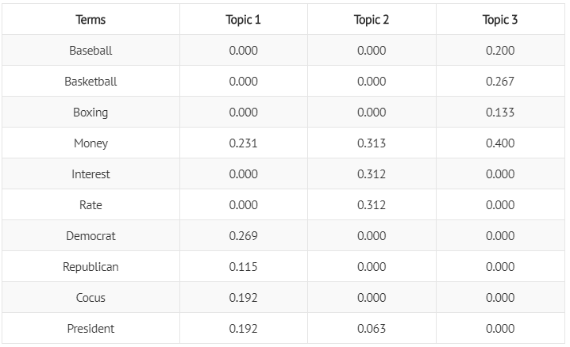
Ɵ(d) - Vector representing the percentage of topics in the dth document - As long as the total number of topics K - Each element value is the proportion of the word in the k-th topic - Each element is a probability, so the sum of all elements is 1

Slide 9
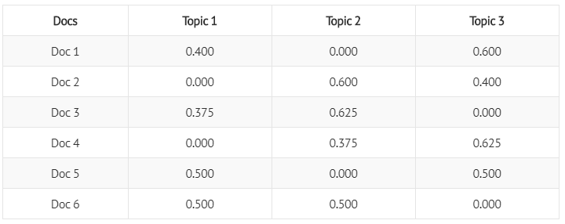
ɸ(k) - - Vector corresponding to the k-th Topic - As long as the total number of words - Each element value is the ratio of the k-th topic to the d-th document - Each element is a probability, so the sum of all elements is 1

Slide 10
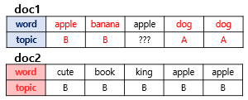
Inference of LDA (word distribution by topic)
1) Customize the number of topics k
2) Assign all words to one of the k topics (Ramdom)
3) Reallocation of topics based on two criteria
p (topic t | document d)
p (word w | topic t)

Slide 11
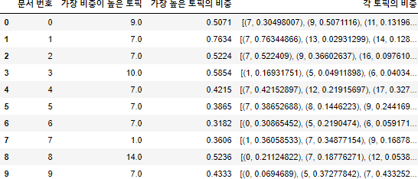
Inference of LDA (Topic Distribution by Document)
The Topic distribution of each document can be found after the entire data has been integer encoded in the LDA model ldammodel[]

Slide 12
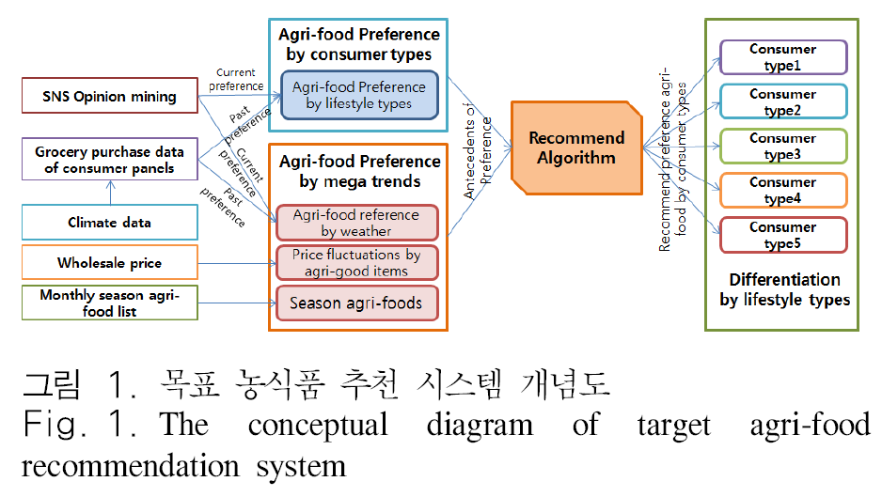
Recommended System Analysis
Purpose
Customizable simplified form with predefined user-specific preferences
Personalized recommendation using personal information
-> Connects with restaurant, external vendor and on-line vendor information through recommendation menu and food materials list

Slide 13
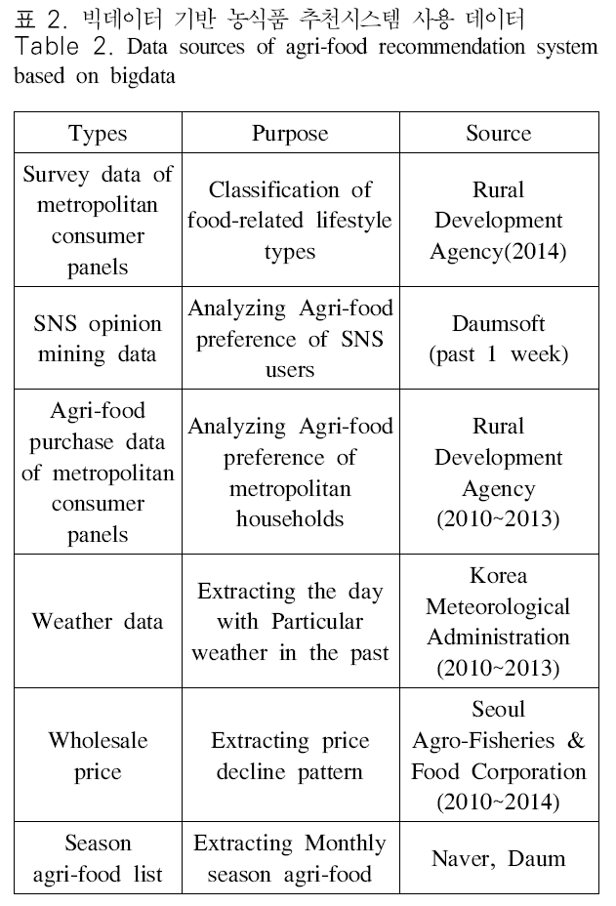
Recommended System Design
Standardize utilization data ranges and lists
Convert 16,000 different menus to 651 standardized menus
The top 99 by consumption amount of vegetables, fruits, livestock and fisheries products were selected as standard food ingredients

Slide 14
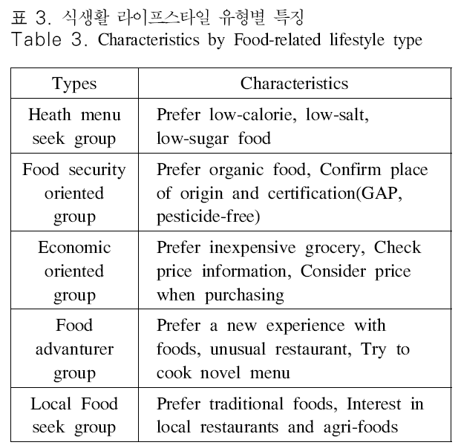
Recommended System Design
Classification of Consumers by Types of Dietary Lifestyle
Analyze the factors of 643 people and extract the measured 38 lifestyle into 10 factors
Select the five different factors by comparing the differences between the demographic variables, the pattern of biodiversity and the purchase amount of each item of the upper group by factor.

Slide 15
Recommended System Design
Recommendation of agricultural products by scientific method
- Megatrends (Weather, Price, Season)
Use of recommended algorithm based on Dirichlet-Multinomial Distribution (Benefits) Easily accept additional feedback and continuous improvement potential

Slide 16
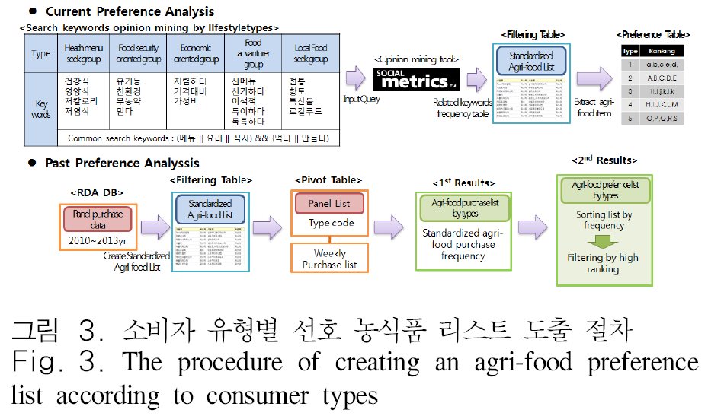
Implementation of the Recommendation System
Creating an agri-food preference list according to consumer types

Slide 17
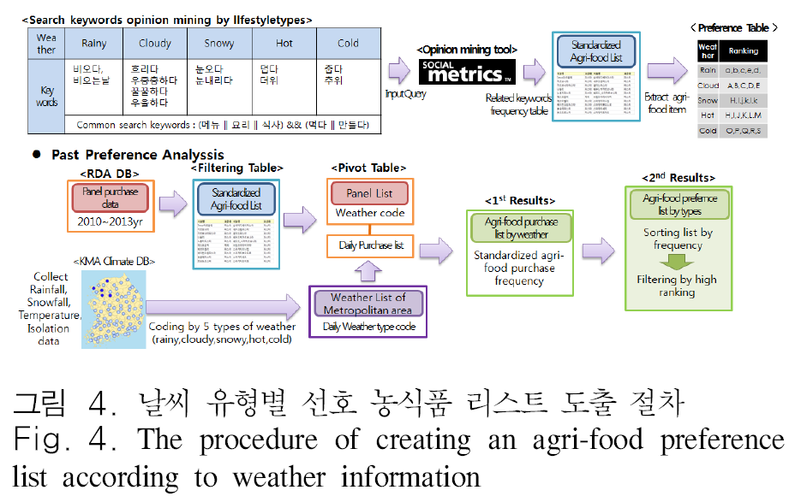
Implementation of the Recommendation System
Creating an agri-food preference list according to weather information (Megatrends)

Slide 18
Implementation of the Recommendation System
Creating an agri-food preference list according to Megatrends
- Seasonal agricultural products
Assuming that each farm product has the same weight, the prior probability is applied equally in the current system
- Drop-price agricultural products
Consumers -> Benefit from buying cheap agricultural products
Producer -> Expansion of demand through recommendation of agricultural products in the face of a sharp drop in prices

Slide 19
Implementation of the Recommendation System
Agricultural product recommendation results by type of consumer
http://data.mafra.go.kr/model/analysis/purchaseInfo.do

Slide 20
Conclusion and Threshold Point
Improve quality of recommended analysis results by utilizing diverse data
Enable accurate recommendations in early stages of service without user base
Develops a Explicit Needs model that can provide valuable information to agricultural consumers
(Threshold Point)
1) Insufficient user evaluation of recommendation results
2) Only five consumer types alone do not reflect the needs of different consumers < Personalized recommendation required >

Slide 21
Future study
Industrial Dimension
Transparency of Hysteretic Information of Food and Agriculture Supply Chain --> Establishment of RFID/USN-based Logistics System
Consumer Dimension
Sophisticated and customizable recommendations --> ubiquitous-based home network technology
- Speech Recognition => To recommend user’s requirements
- Biometric recognition => To recommend a diet that reflects a user's health status in real time

